Slide 1
Two lucky winners will each receive a water bottle and tote provided by Siete and a $100 American Express gift card provided by NFP.
Two (2) $100 American Express Gift Cards provided by NFP
Water Bottle and Canvas Tote provided by Siete

Slide 2
AHRMA 9-30-20
Thank you for holding Austin together, while driving us forward. We are honored to sponsor this event.
Greatly appreciating you,
Your Friends at NFP
Corporate Benefits | Property & Casualty | Individual Solutions
www.nfp.com
Engage us via NFPCSTexas@nfp.com.

Slide 3
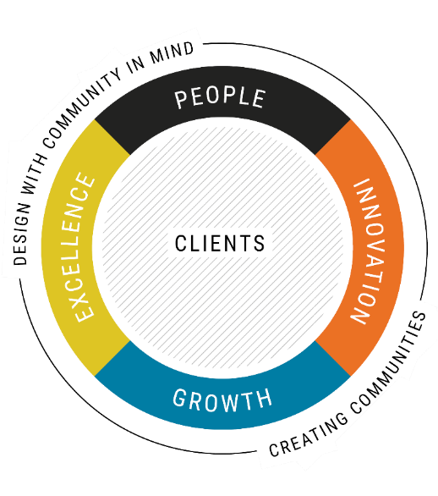
2020 Strategic Plan
Our goal: to better serve clients by achieving the objectives laid out in four value creators
Clients are at the core of our value creators. We need to always ask ourselves “how are we adding value for our clients?”
How does I&D enable the plan?

Slide 4
Stantec’s Journey
First Engagement and Inclusion Survey
Maintaining engagement in the Covid era via ERGs
Stantec business objectives include Inspired, inclusive culture
Unconscious Bias Training as part of Senior Leadership Summit
Unconscious Bias Sessions offered as optional
Social Justice and Anti-Racism
ERG Framework, starting with Women@Stantec
Unconscious Bias Training virtual delivery
Leadership Summit closes with two personal inclusion stories
2015 2016 2017 2018 2019 2020
Concept of ‘Talentism’ Introduced by new CHRO
Unconscious Bias Training Pilot
Expansion of I&D Councils and Unconscious Bias beyond North America
Creation on Inclusion Moments in partnership with Emerging Leaders
Female-focused advancement pilots, including SponsorHer@Stantec
Development of I&D Strategy
Expansion of ERGs: Pride@Stantec, LatinosInStantec, Military, PWD, Asian
First Pulse Survey – engagement and inclusion
Establishment of first I&D Council

Slide 5
Aligning Culture and Strategy
Organizational Effectiveness
Organizational
Performance
Organizational Health
CULTURE

Slide 6
3
Key Components of Organizational Performance
Leadership &
Management
Aligned with
Mission, Vision
& Values
Organizational
Strategy
Organizational
Transformation
Balanced
Scorecard
Organizational
Structure
Role Clarity
Performance
Management
Organizational
Climate
Organizational
Performance
Aligned
Systems,
Process, Policy
& Procedure
Organizational
Culture
Attract, Retain,
& Develop
Diverse Talent
Creative,
Innovative &
Competitive
Discretionary
Effort is
Disbursed
Cognitive
Diversity is Leveraged
Employee Engagement

Slide 7
Krissy Ager
Johnny Reyes
Please contact the AHRMA office for delivery.

Slide 8
Ricardo Carlos (He/Him/His), SHRM-SCP, CPHR Director, Global Inclusion, Diversity and Engagement Direct: (512) 469-5330 Mobile: (737) 300-5317 Ricardo.Carlos@stantec.com
Anita F. Paige, Sr. Vice President The Edge Advisory Group Direct: (913) 204-0602 Anita@theedgeadvisorygroup.com

